Slide 1

Internships
WHY??
Notes:
Take a look at this short video clip about the value of internships
Take a look at this Ted Talk video about internships before moving on….. https://www.youtube.com/watch?v=cRcTKfziGOE
https://www.youtube.com/watch?v=8LgNkadOI24

Slide 2

What it might look like
Internship Experiences

Slide 3

Internships
Internship Homepage
8 credit, 320 clock hours
Time frames - EIU Calendar
Notes:
All of the information found in this powerpoint can also be found at the Internship Website. The next slide will explore the internship webpage. Be sure to check with advisor about hours and be aware of financial aid restraints. The internship must take place during the semester dates – check the EIU calendar to see specifics.

Slide 4


Slide 5
Requirements And Deadlines
Prerequisites:
PUBH 3700, 4175, 4250.
Submission of the Professional Portfolio
Internship Offer:
November 15 (for Spring Internships)
March 15 for Summer Internships)
July 15 (for Fall Internship)
Internship Agreement Form signed by all:
December 1 (for Spring Internships)
April 1 for Summer Internships)
August 1 (for Fall Internships)
Notes:
There are prerequisites as you see here. We’ll talk about portfolios in another presentation. And there are deadlines for having the internship arranged each semester. By arranged it means that all details have been completed and all forms signed by the agency and the university to approve the internship

Slide 6
Procedures
Meet with your PUBH Academic Advisor
Read and review ALL information at website
Complete Intent to Intern Form
Notes:
DO NOT make contact with a site UNTIL you have……the intent form can be found at the internship website

Slide 7

Notes:
Intent to Intern Form

Slide 8

Site Selection
Criteria
  Eight Areas of Responsibilities for Health Educators Specialists.
Site Selection resources
  Internship List and Search Engines at website
Settings
Notes:
To determine if a site is suitable for an internship for a Public Health major, the Seven areas are used as the criteria. If you can gain experience in one of the competencies or sub competencies listed here – you are good to go. To help you start thinking about possible internship sites, you should visit the Internship list and search engines provided at the internship webpage.

Slide 9
Where Public Health Specialists Work…
Notes:
This part of the presentation will walk you through some information about where public health specialists work. Basically these settings are all potential internship settings. So as we go through some of the settings – see if any spark your interest. That’s where you start looking for your future internship

Slide 10




Community/Public Health Settings
Non Profit Voluntary Agencies
Notes:
In the community or public health setting, non profit agencies offer many opportunities for internships – and there are a lot of non profit agencies. Here are a few examples – and many more can be found here.

Slide 11




Government
Federal Health Agencies
CDC
Notes:
Government agencies at the county, state, and federal levels are also good possibilities for internships. This link takes you to a list of agencies and this one gives you an example of some at the CDC

Slide 12


Government
State & Local Public Health Departments
Emergency Management Agencies
Notes:
Government agencies are also found at the state and local levels such a s local public health depts and some other s you see here. These links will take you some lists and contact information some additional government agencies.

Slide 13



Business & Industry
What is Worksite Wellness
Worksite Health Promotion (WHP)
  Wellness/health promotion
  Occupation health & safety
  Employee Assistance Programs
  Infection/Hazard Control
  Injury Prevention
Notes:
Within business and industry one of the rapidly growing areas is worksite wellness or worksite health promotion. This link will provide you with a description of WHP and these other links will et you explore some specific internships available. In this area. Most major companies and corporations are providing health promotion as incentives for their employees. These are some of things that happen in a Worksite Health Promotion Program

Slide 14
Business & Industry
Insurance
Sales – medical/health/fitness equipment
Pharmaceuticals
Health Communication
Notes:
Here are some additional areas within business and industry in which a health education specialist may end up working – and potentially are sites for internships. Do some exploring by clicking on the links…

Slide 15

Health Care Settings
Notes:
There are many settings within health care that health educators work – checkout the next few slides

Slide 16






Health Care Settings
Hospitals
Clinics
Retirement Facilities
Managed Care
Notes:
We’ll talk more specifically about hospitals in a minute. Clinics are often topic specific i.e. HIV, homeless, mobile, tribal, migrant…
Retirement facilities such as Assisted Living- Senior Housing –Nursing homes are numerous and found in just about every town and city
Managed care organizations are health insurance plans that contract with health care providers and medical facilities to provide care for members at reduced costs. You may recognize some of these names. They are potential site for interns especially if interested in the business side of health care

Slide 17



Health Care Settings
Home Health Agencies
Rehab facilities
Substance use prevention agencies
Mental Health
Notes:
Other health care settings include what you see here. You can google any of these and find specific information about am agency or facility near you.

Slide 18
A Word about hospitals….
Non-medical Administrative services operations in a hospital…
Notes:
When asked where an student wants to do an internship, the answer is frequently “in a hospital”. Well – you’ll need to narrow it down significantly! Since our major is a non clinical program, interns cannot be involved with direct patient care. So the next few slides will talk about the Non-medical Administrative services operations in a hospital

Slide 19
Compliance Department
Prevent, detect, and correct employee violations of the Federal, State, or local laws, or institution policy and procedure violations.
HIPAA
Notes:
Healthcare compliance is a general term describing the observance of conventions, guidelines, and state and federal laws. Practices, clinics, and facilities normally have a staff members or an entire department dedicated to compliance

Slide 20
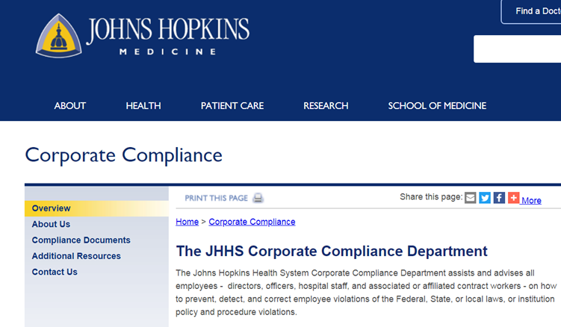
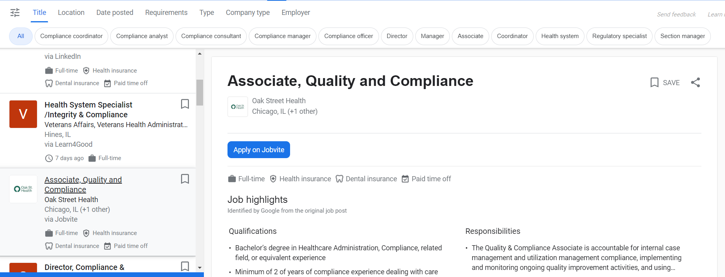
Notes:
Here are some examples….

Slide 21
Education & Training
Medical
Patient Educators
Community Education/Services

Slide 22
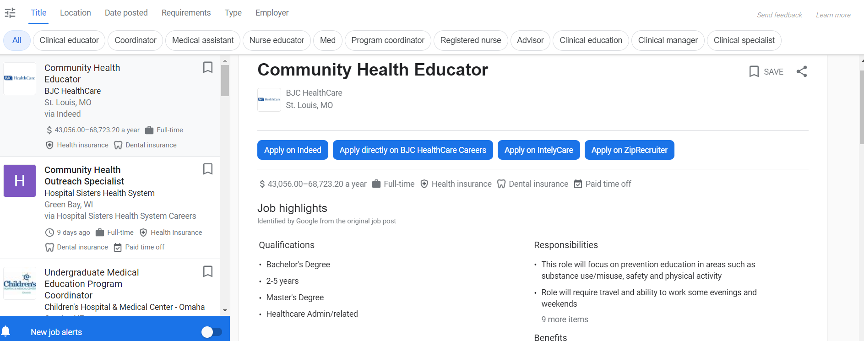

Slide 23
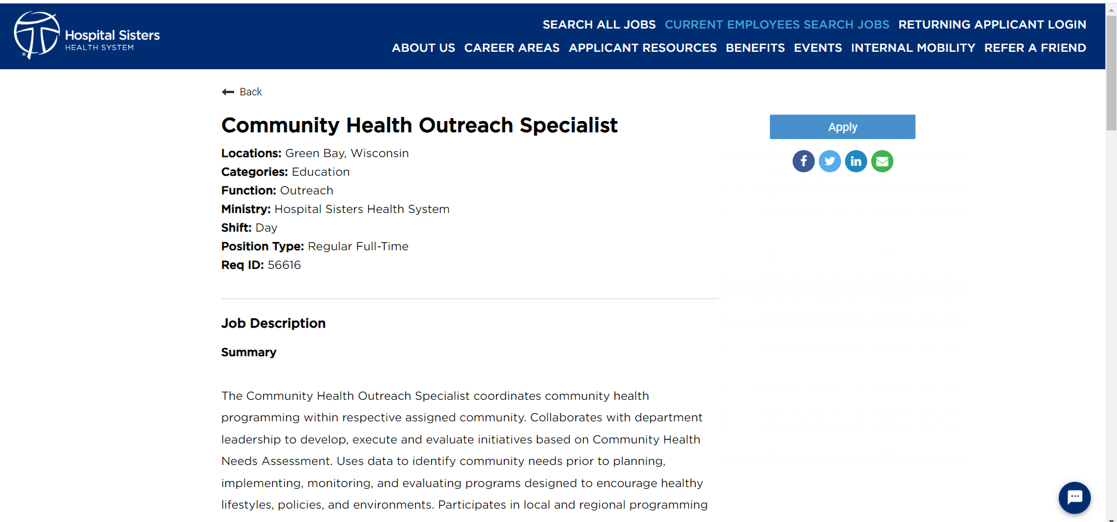

Slide 24
Development
Fundraising
Grants
Foundations

Slide 25
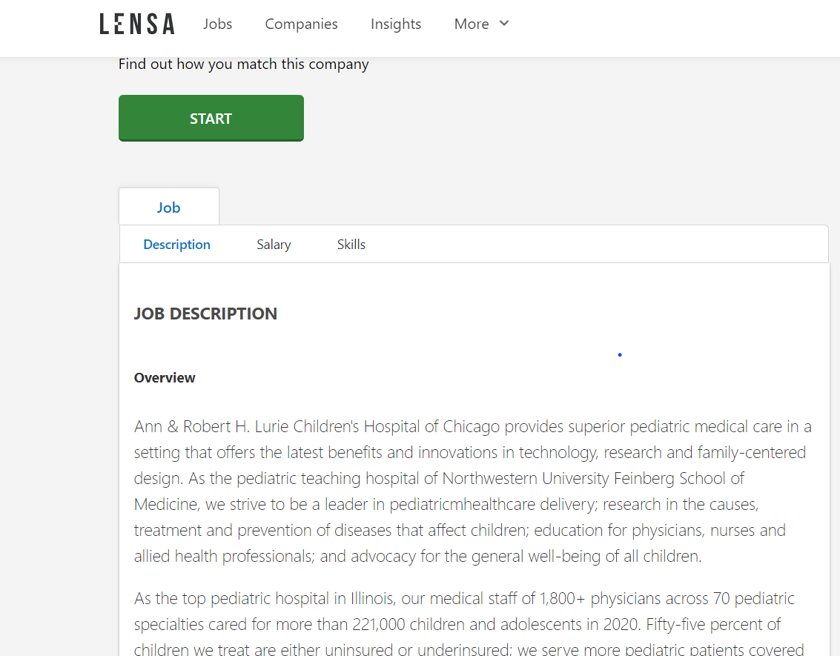
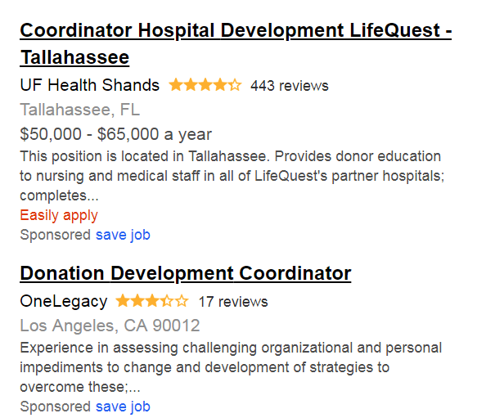


Slide 26
Health & Safety
Occupational safety and health
Environmental control
Fire safety
Safety-oriented training programs
Emergency management
Notes:
Health and safety departments provide guidance of the safety program including occupational safety and health, environmental control, fire safety, safety-oriented training programs, emergency management/disaster preparedness.

Slide 27




Slide 28

Human Resources Department
Notes:
Ensure the quality and motivation of personnel working at the hospital.

Slide 29
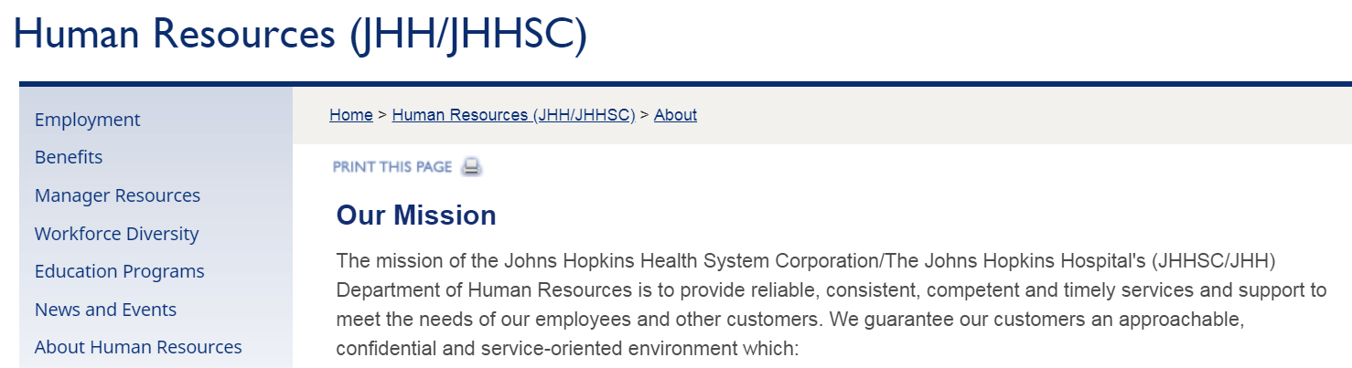
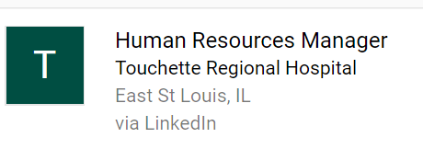

Slide 30

Operations Dept.
Planning and controlling change.
Managing quality assurance programs.
Researching new technologies and alternative methods of efficiency.
Setting and reviewing budgets and managing cost.
Overseeing inventory, distribution of goods and facility layout.
Notes:
Oversees appointment scheduling, patient registration, billing and payment, admissions and discharge, managing beds, diagnostics reports delivery etc. An operations manager will have to ensure all these activities are being done properly so that patients get the best service. They would have to handle and resolve patient complaints and manage the staff performing all the operational jobs.

Slide 31
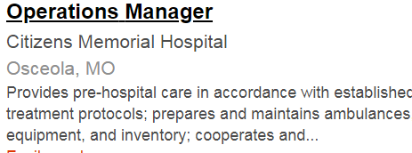

Slide 32
Infection Control
Responsible for direction, management and operation of the infection prevention and control/epidemiology department, including education of hospital personnel and consultation with the organization, CDC, and the county and state health departments.
Compliance with Joint Commission (JC) standards, CMS, OSHA, and state regulations, outbreak investigation, and overall direction of the infection prevention and control program.
Notes:
Infection preventionists are experts on practical methods of preventing and controlling the spread of infectious diseases, typically within a specific population—the patients, staff, and visitors at a hospital or other health care setting

Slide 33
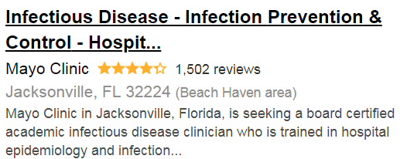

Slide 34
Marketing and Communications
Media relations
Editorial services
Web strategy
Development and digital media, design
Marketing, and market analysis
Notes:
Media relations, editorial services, web strategy, development and digital media, design, video production, marketing, and market analysis and planning.

Slide 35


Slide 36
Job Description: Communication Specialist
Maintain internal and external communication strategies.
Meet with internal clients to determine communication needs for departments
Provide updates to website and website structure enhancement
Writes edit and disseminates media
Monitor social media, contributes to social media posting calendar and tracks engagement data.

Slide 37
Examples- Hospital Departments
Johns Hopkins
Examples:
Healthcare Internships in Chicago

Slide 38

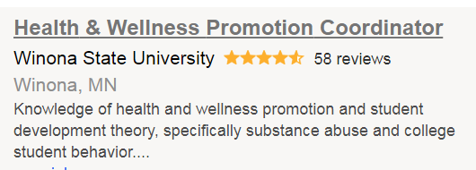
Colleges/Universities
University Health Service or Wellness center
  e.g. HERC
Notes:
Most Colleges and universities have a student and faculty health promotion or wellness program in addition to the clinical services they provide.
Check out our HERC to see what kind of things happen in this setting

Slide 39
International
Disease prevention, health promotion
APHA Global Internships
GVI

Slide 40

Notes:
Check out Americorp – they often offer internships for students like you.

Slide 41
Possible agency requirements…
Vaccinations….
Health records….
Criminal background checks….
Notes:
These are some things that a particular site might require before they will accept you as an intern. Be prepared – more and more sites are requiring these. Be sure to use the EIU career services for help with a good cover letter – this can make or break a potential internship

Slide 42
Procedures…
Schedule an appointment with the Undergraduate Academic Advisor
Make an appointment with the Internship Coordinator
DO NOT make contact with a site UNTIL you talk to the Internship Coordinator

Slide 43
Prior to the meeting
  Review information for identifying a site - Site Selection
  Be familiar with the Eight Areas of Responsibilities for Health Education Specialists.
  Be familiar with Competencies and Task Form.
  Review Portfolio Guidelines
  Have at least a draft of your Resume and Cover Letter

Slide 44
After the meeting:
Submit the Internship Site Identification Form
  Include ALL required information…
  For on-line applications…..

Slide 45
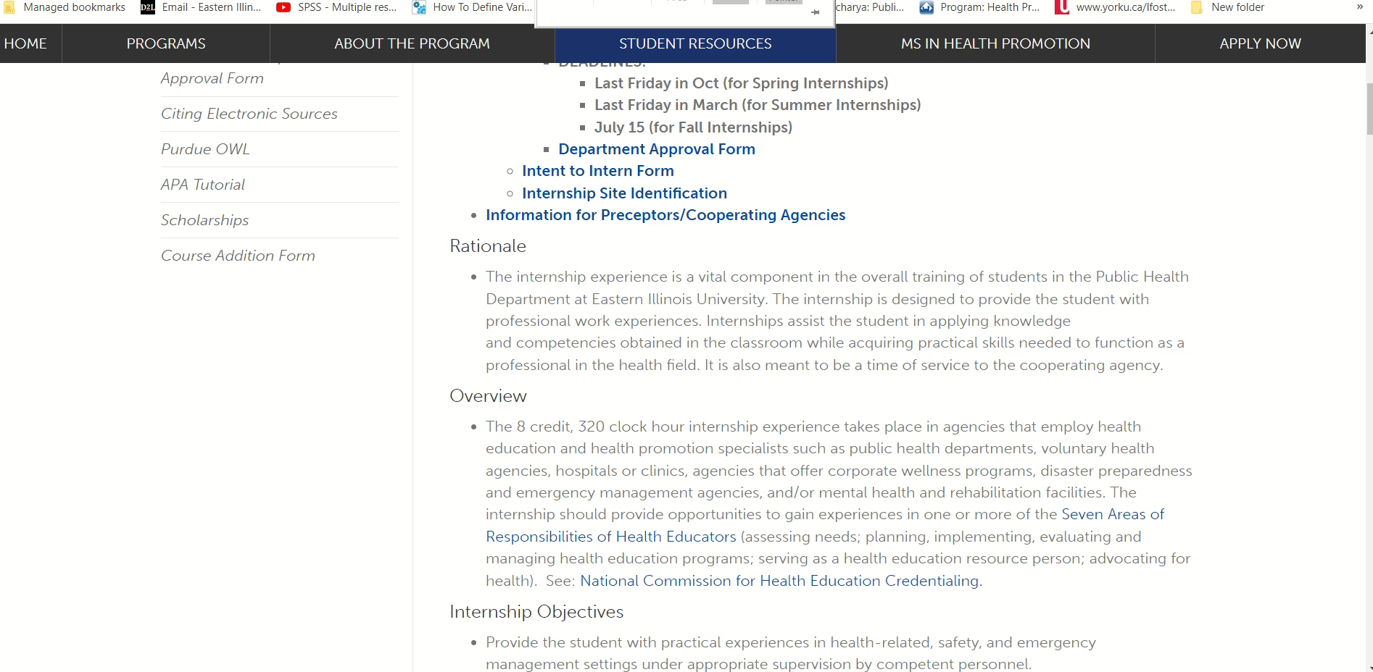

Slide 46
After the Meeting….
Stay in touch

Slide 47
Procedures….
Agency Meeting or Interview
  Research the agency
  Be very familiar with internship objectives and the agency
If an internship is offered and accepted, report beginning and ending dates anticipated for the internship to the Internship Coordinator

Slide 48
Student Internship Agreement Form
Completed once internship is accepted and dates decided
Signatures needed ….by everyone…
The internship will then be officially arranged.
TIME….

Slide 49
Requirements During the Internship
Comply with ALL agency/organization policies and guidelines
Weekly Logs
Final Summary Report
D2L Section

Slide 50


