Slide 1
Adult Fitness Program

Slide 2
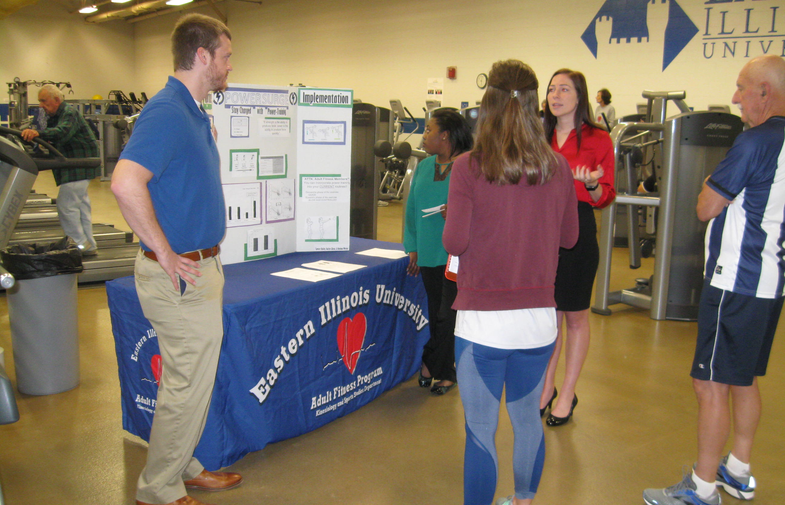
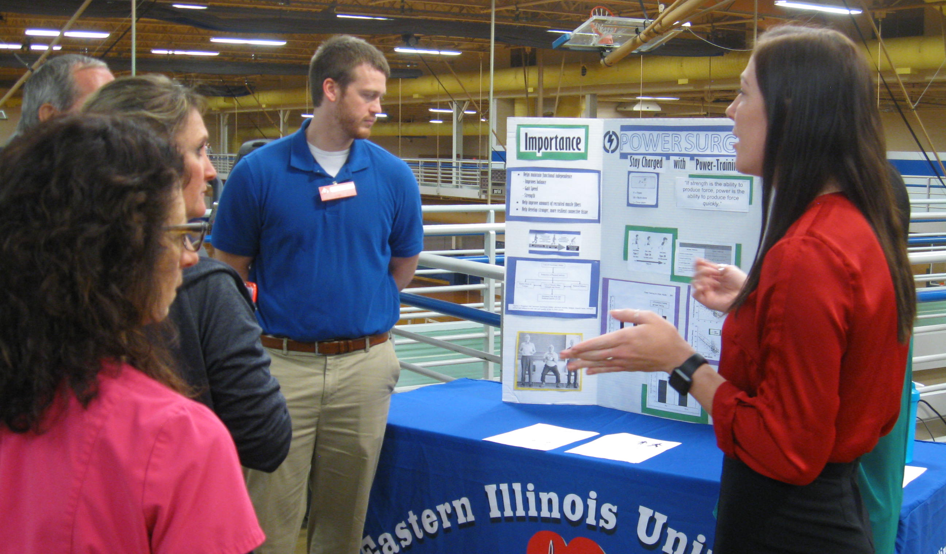
Adult Fitness Educational Series

Slide 3
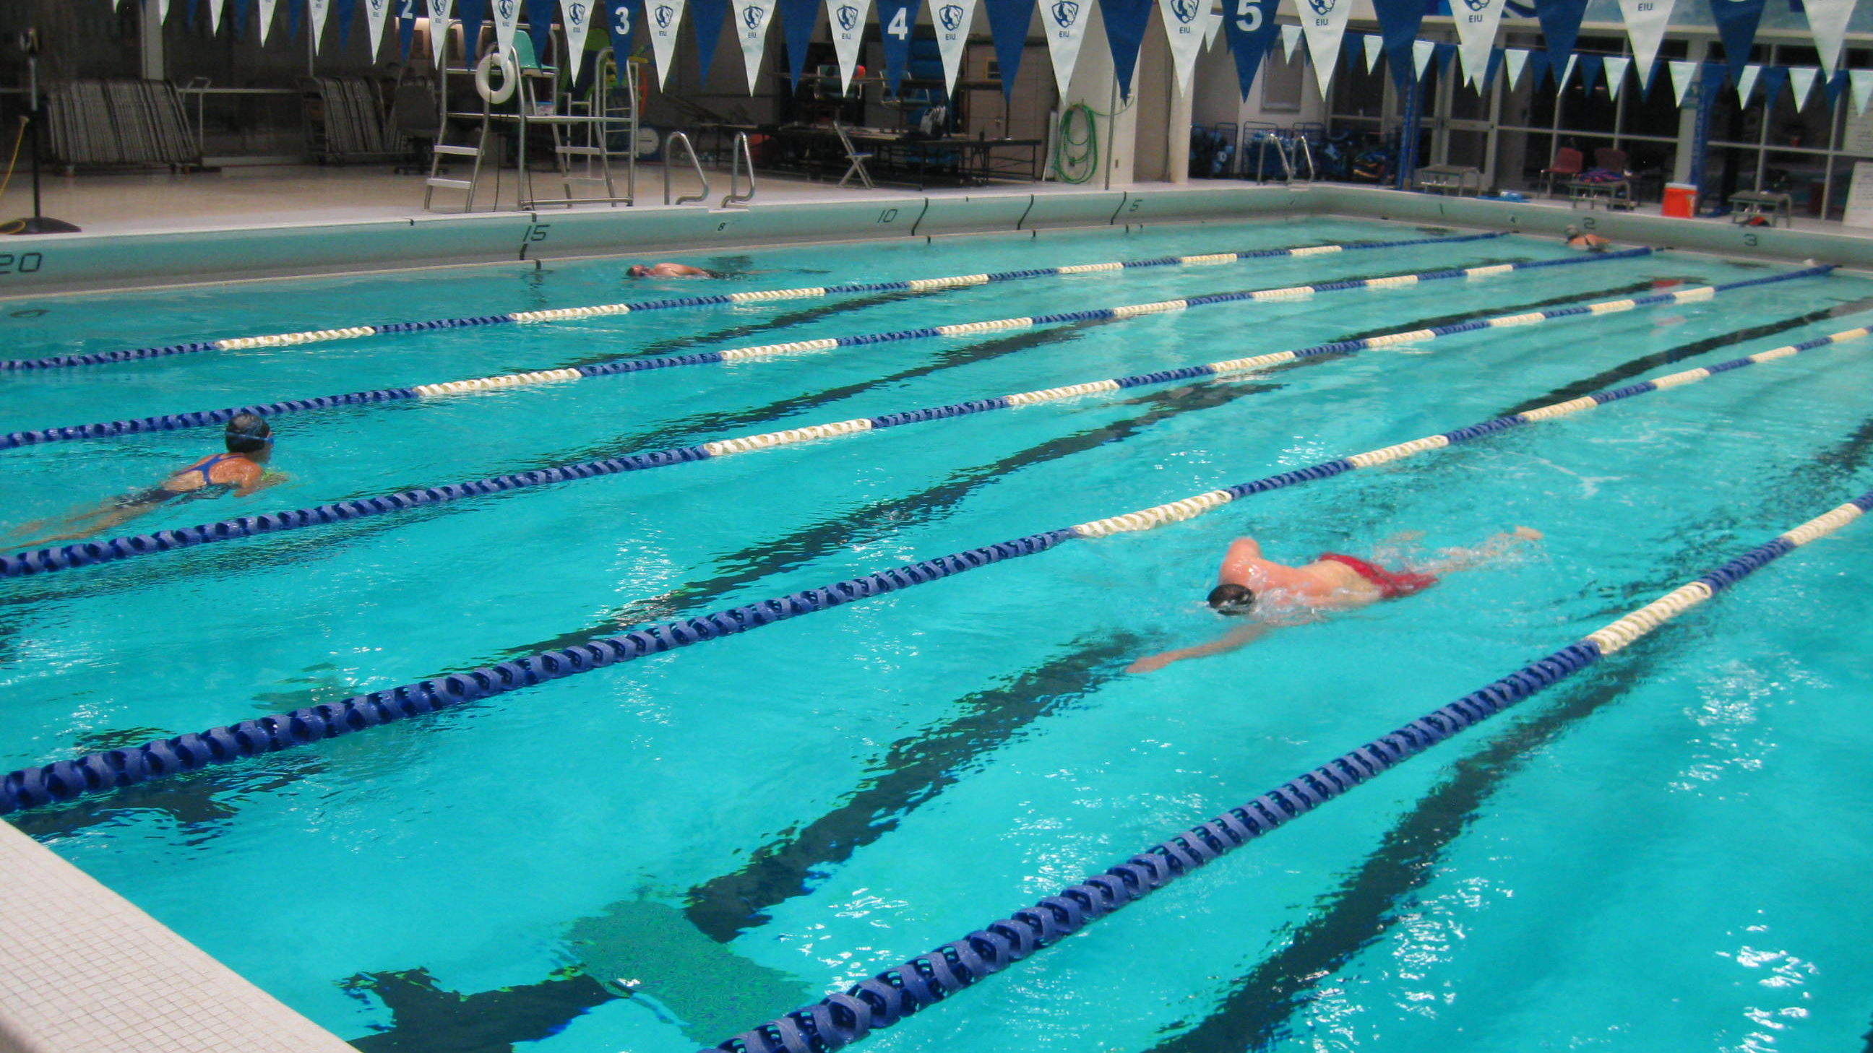
Swimming

Slide 4
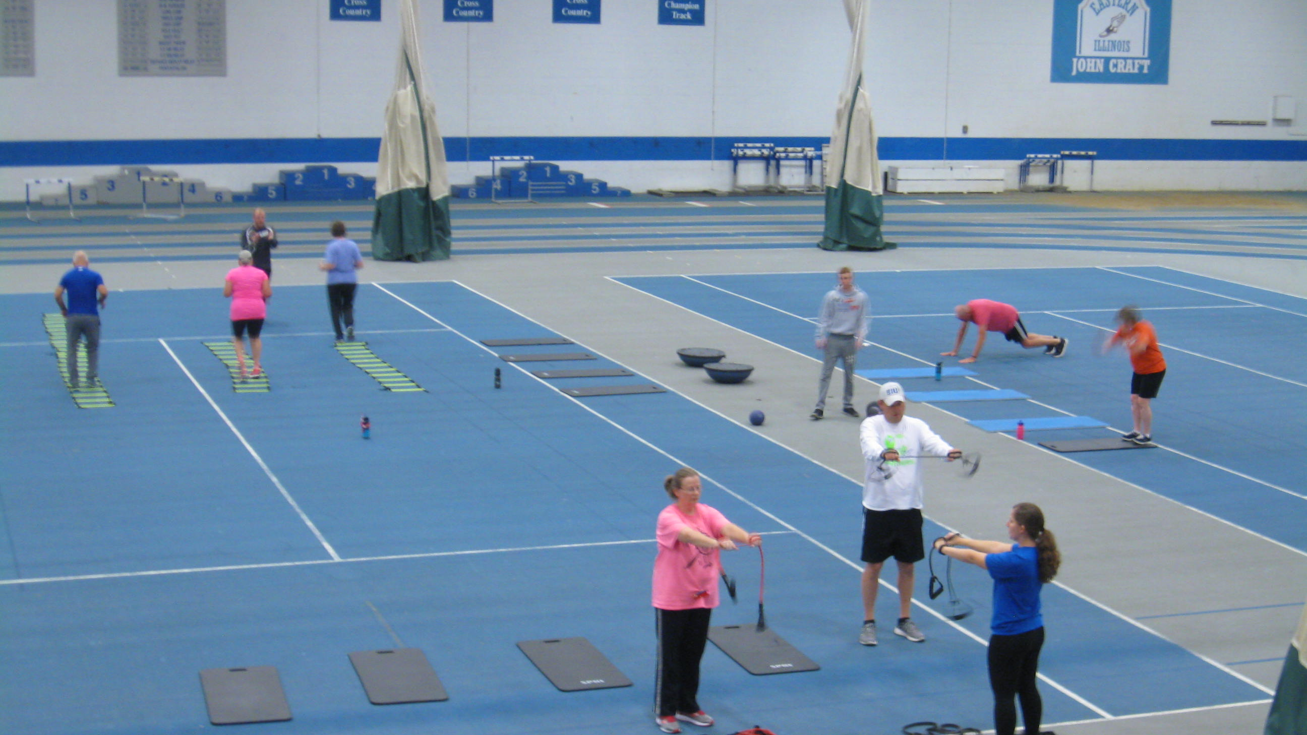
Bootcamp

Slide 5
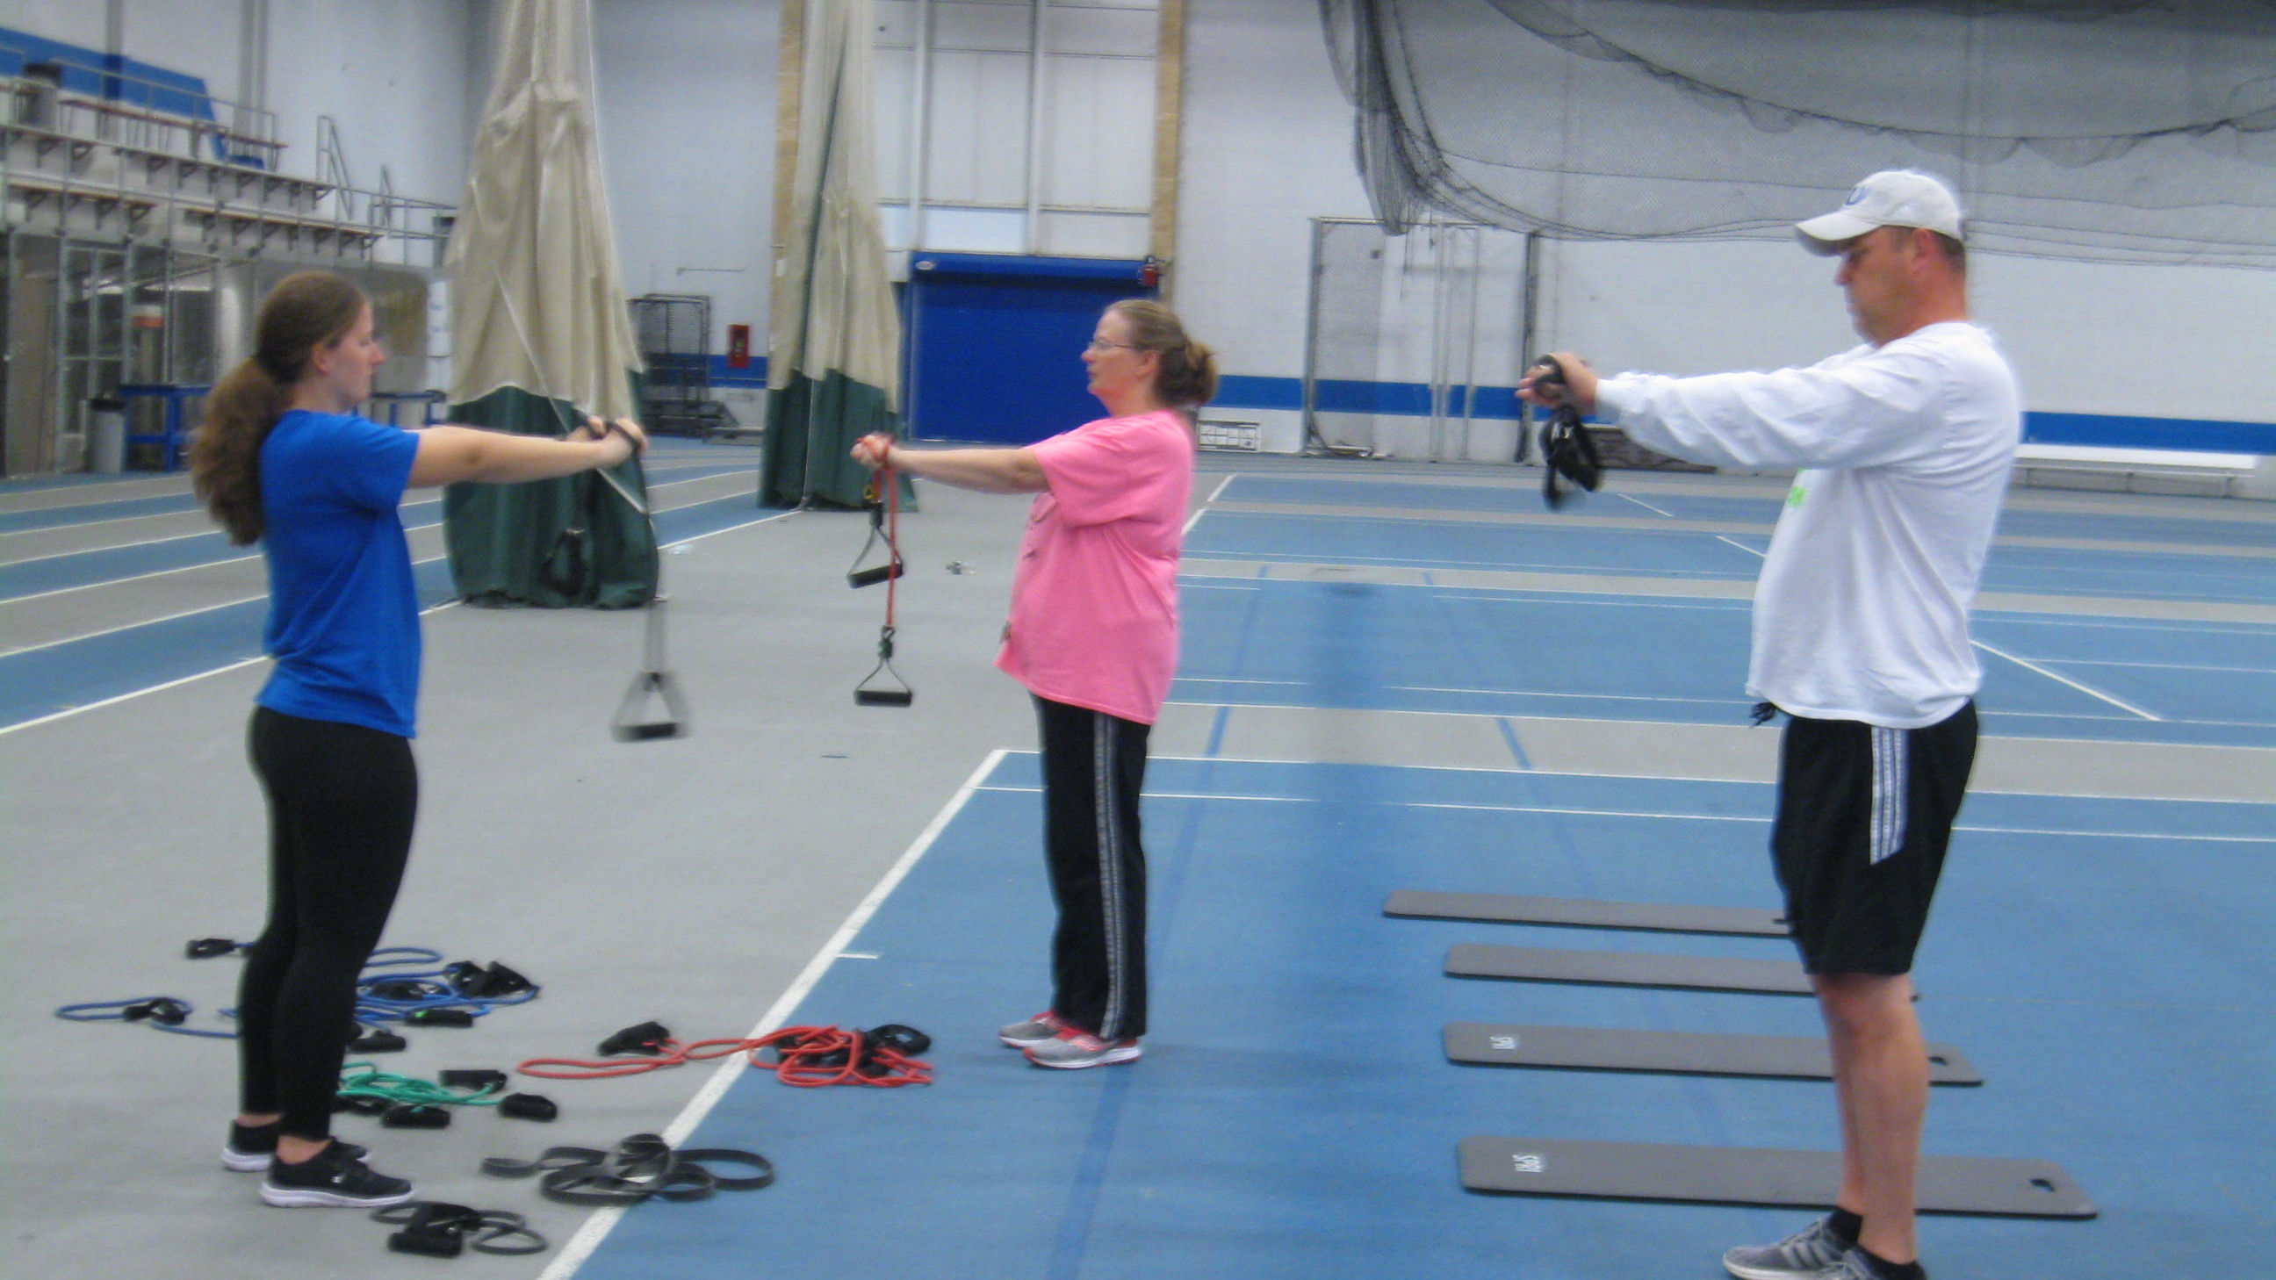

Slide 6
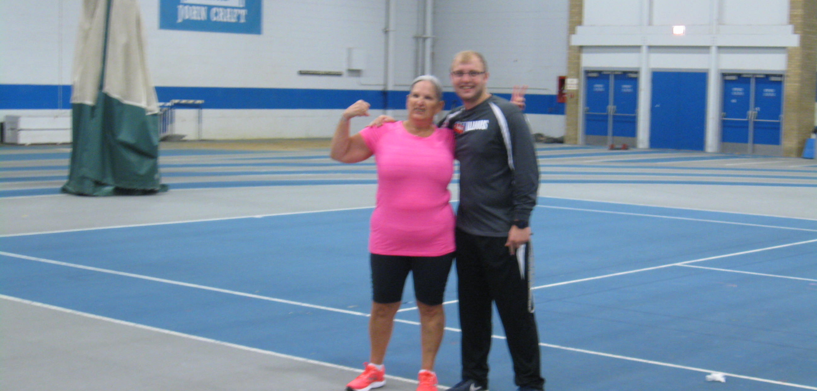

Slide 7
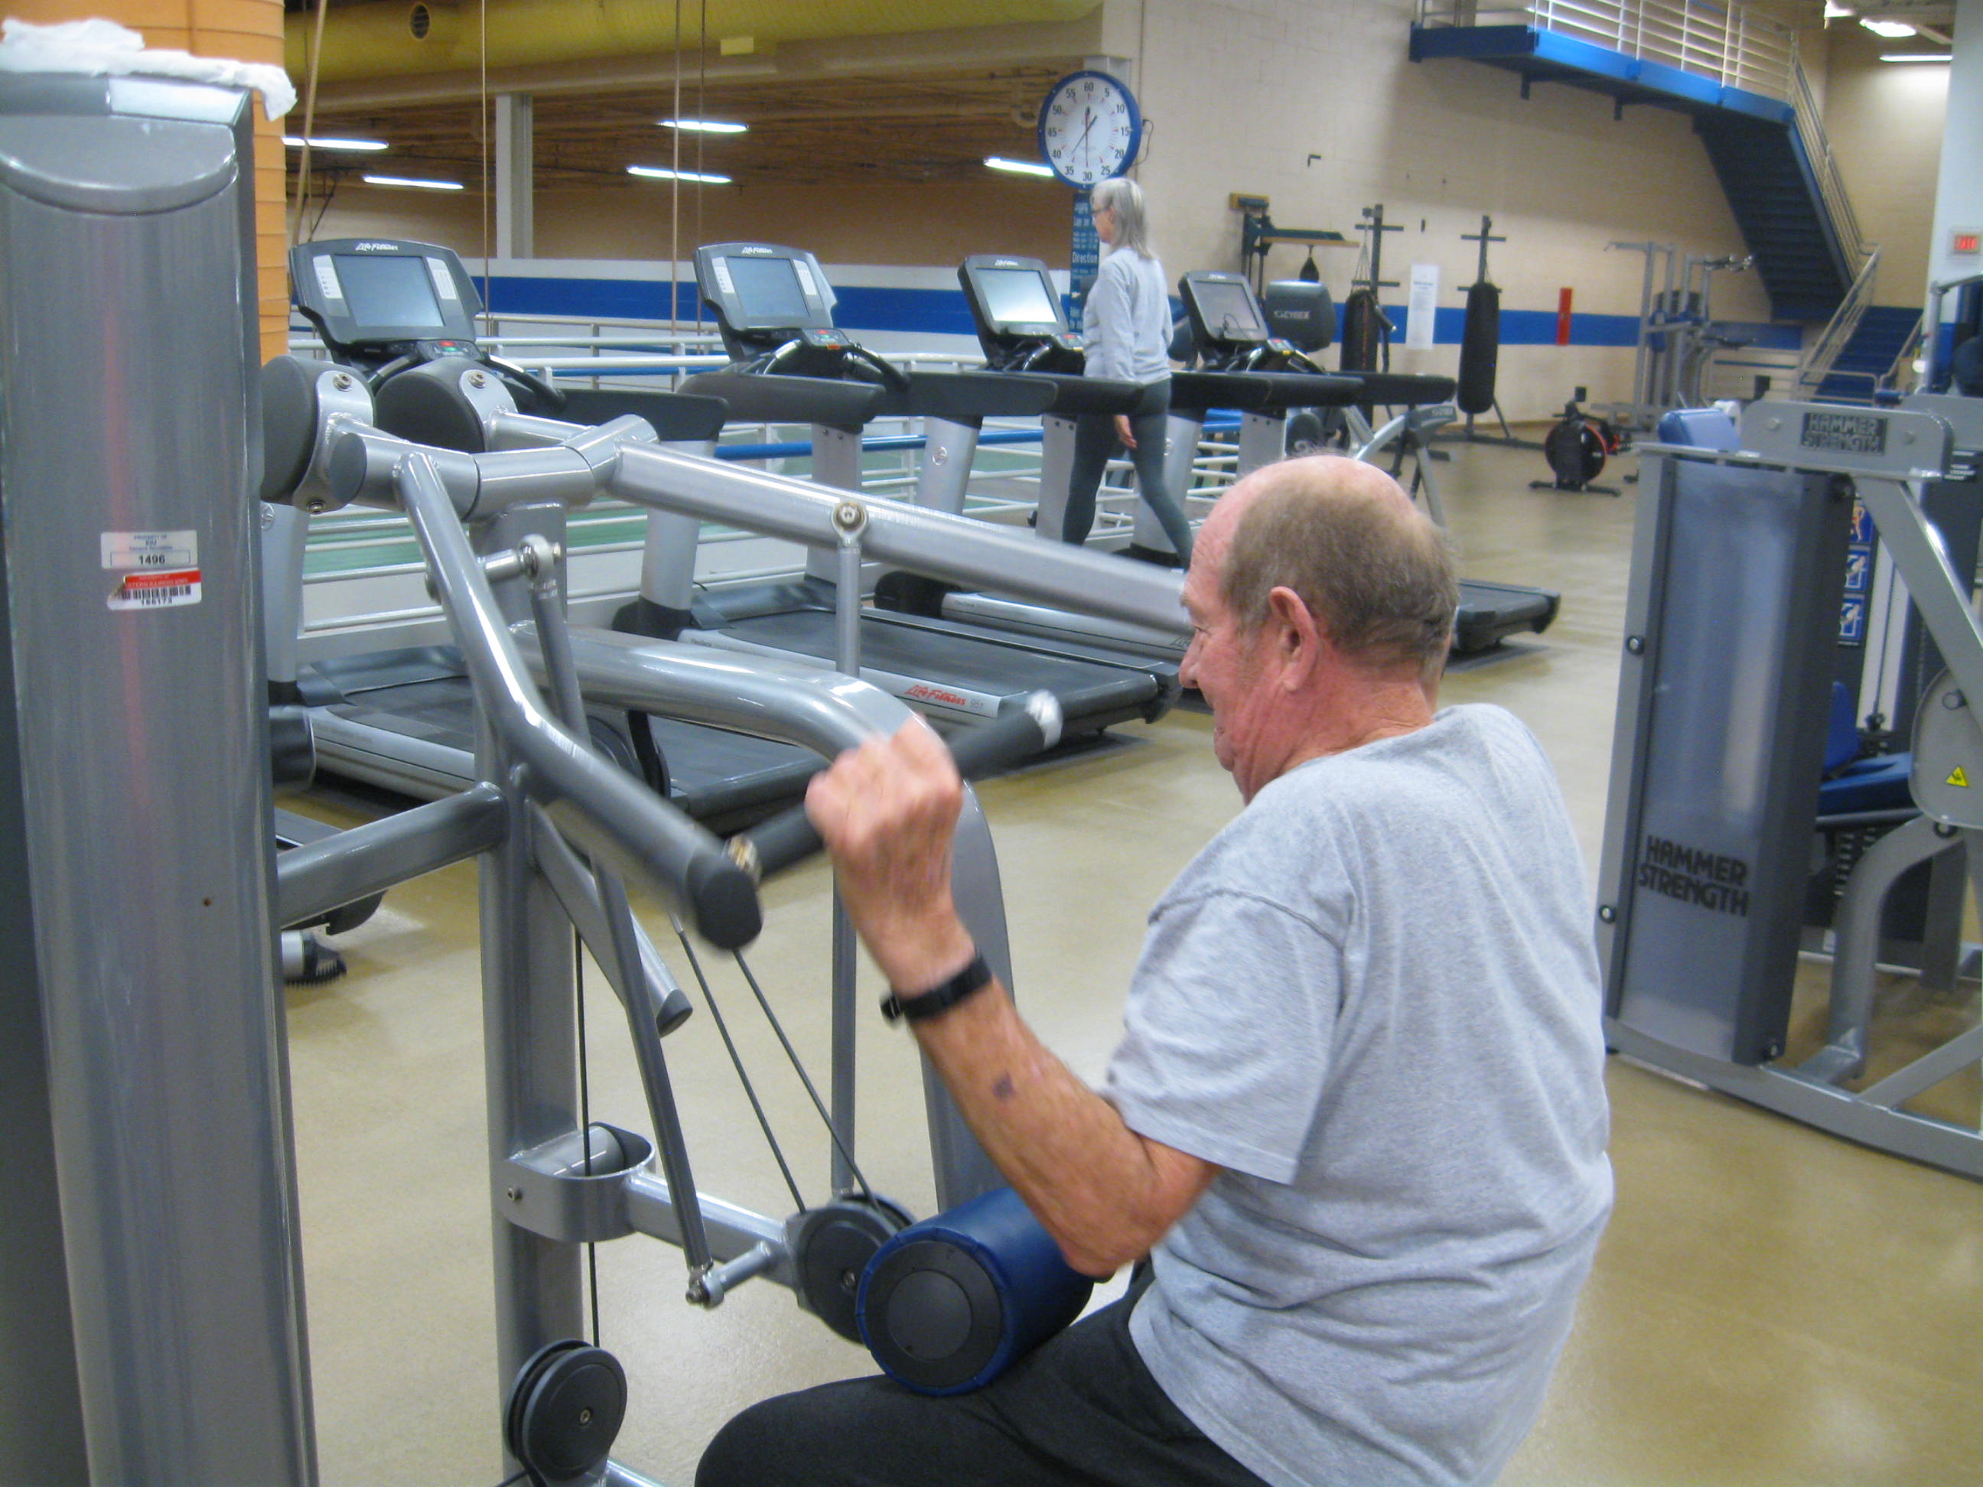
Recreation Center

Slide 8
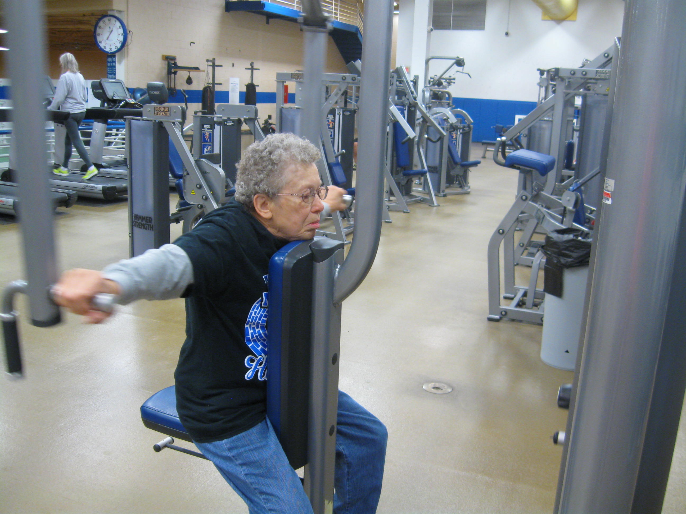

Slide 9
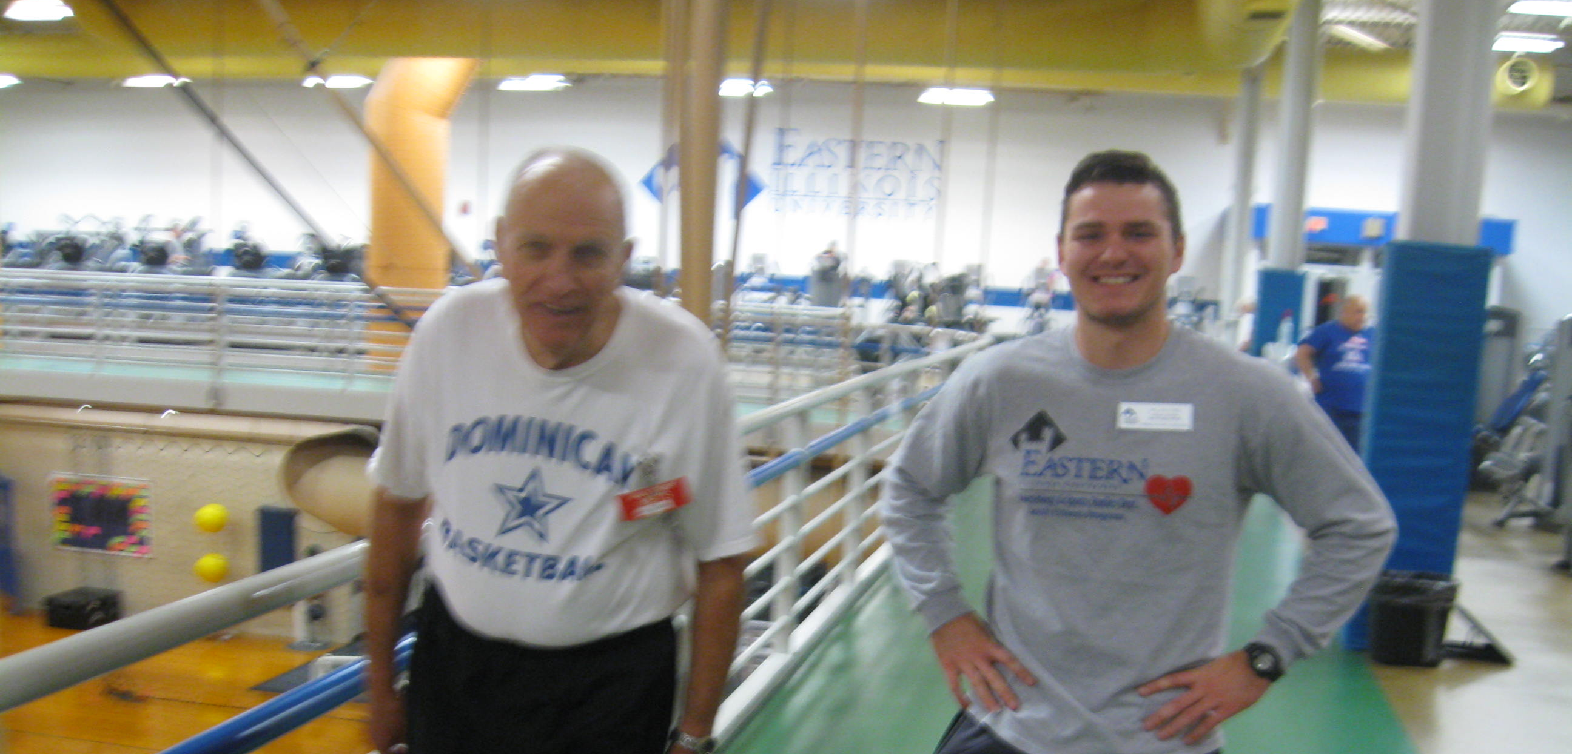

Slide 10
Come see us!
Stop in to the ATP lab for a full body assessment
OR
Join our Adult Fitness Program!!
We would love to have you!

