Slide 1
Building a Comprehensive Harm Reduction Program for Fraternity and Sorority Life: Southern Illinois University Carbondale’s Alcohol Education Program
Brianna Sinche, MPH Wellness Coordinator Southern Illinois University Carbondale

Slide 2
Objectives
1.
Identify common challenges of implementing alcohol and other drug education within Fraternity and Sorority Life.
Understand how a harm reduction program or harm reduction principles can be implemented with Fraternity and Sorority Life.
Identify new or alternative ways to effectively educate and engage the Greek community around topics of alcohol and other drugs, hazing and sexual assault.
2.
3.
B. Sinche 2018

Slide 3
Southern Illinois University Carbondale
14,554 students (2017)
Rural area
Research institution
Diverse student population (29% minority)
History of “party school”
Chicago
Carbondale
B. Sinche 2018

Slide 4
Addressing Alcohol Use at SIU
Harm Reduction Messaging
Social Norms Campaign
BASICS
Alcohol Classes
Mandated Assessments
B. Sinche 2018

Slide 5
Addressing Alcohol Use at SIU
Harm Reduction Messaging
Social Norms Campaign
BASICS
Alcohol Classes
Mandated Assessments
Harm Reduction
Strategies that aim to reduce the harms associated with various behaviors. ⁷
Eat before and during drinking
Use with people you know
Use condoms and lube
Portion control
B. Sinche 2018

Slide 6
Addressing Alcohol Use at SIU
Harm Reduction Messaging
Social Norms Campaign
BASICS
Alcohol Classes
¹⁵
Mandated Assessments
B. Sinche 2018

Slide 7
Alcohol and Greek Life
High-Risk Alcohol Use
Integration into FSL
Housing
Self-selection Process
Social Norms
Alcohol Expectancies
²
^{4, 8}
^{2, 3, 13, 17}
^{2, 5, 10, 18}
^{2, 14, 19, 22, 24}
B. Sinche 2018

Slide 8
Alcohol Use in Greek Life
Alcohol Use
Greeks consume more alcohol and experience more alcohol-related problems than non-Greeks. ^{1, 2, 20}
binge drinking significantly higher. ^{1, 5, 17}
one and a half times more likely to forget what they did or where they were after drinking. ²³
positively associated with driving after drinking ¹² and owning a fake ID. ¹⁶
Alcohol as a Weapon
Half of all sexual assaults occur while with the perpetrator, victim or both were drinking alcohol. ^{6, 25, 26}
Women who drink on college campuses are more likely to be the victim of a sexual assault. ¹¹
Over half of incapacitated rapes occur at parties. ²⁷
Fraternity and sorority membership is associated with increased risk for sexual assault.^{23, 28}
Sorority members who binge drink are significantly more likely to be sexually victimized and engage in unwanted sex than non-Greek female binge drinkers. ²⁰
B. Sinche 2018

Slide 9
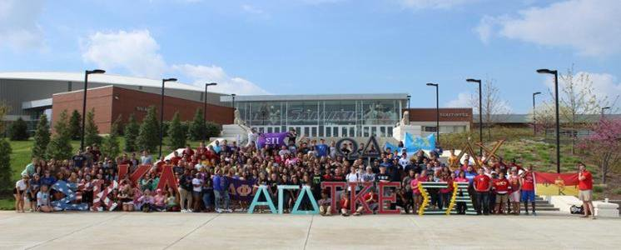
Fraternity and Sorority Life at SIU
Over thirty organizations and 1001 students
Four governing councils
College Panhellenic Association
Interfraternity Council
Multicultural Greek Council
National Pan-Hellenic Council
High philanthropic activity
High campus engagement
B. Sinche 2018

Slide 10
Past efforts and challenges
Silo system of programming
Participation
Scheduling issues/last minute requests
Lack of contact with chapter leaders
Changes in staff in both FSL and Wellness
B. Sinche 2018

Slide 11
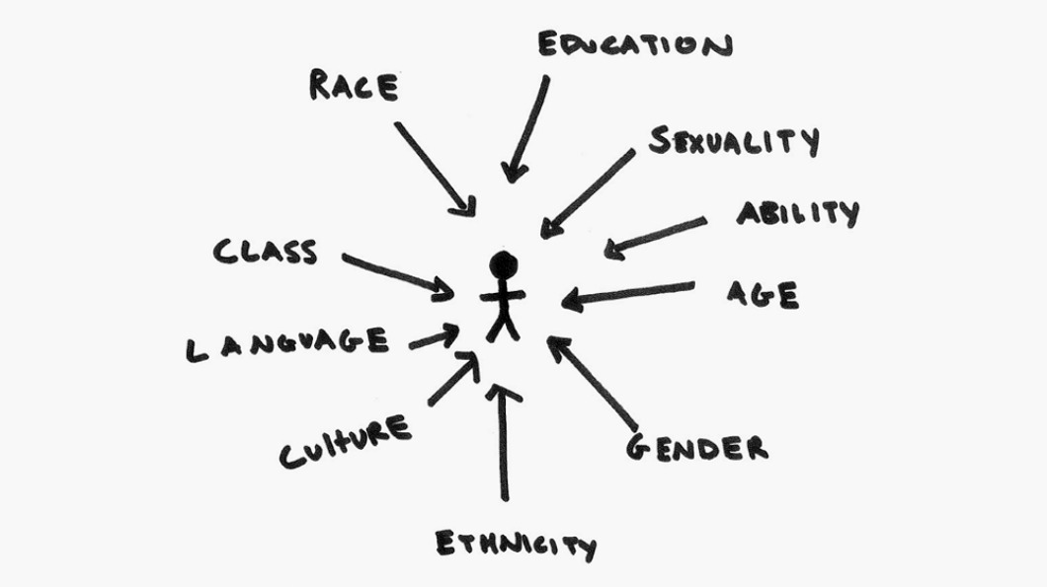
Intersectionality
Intersectionality:
the complex, cumulative manner in which the effects of different forms of discrimination combine, overlap, or intersect. ⁹
Image from: International Women’s Develop Agency
B. Sinche 2018

Slide 12
Intersectionality in Alcohol Education
Alcohol and Other Drug Use
Nutrition and Physical Activity
Academics
Romantic and Non-romantic Relationships
Hazing
Sexual Health
Mental Health
B. Sinche 2018

Slide 13
New Format of Programming
Leader Training
Alcohol, hazing, healthy relationships
New Member Education
Alcohol, hazing, healthy relationships and sexual health
Continuing Education Series
Alcohol, hazing, healthy relationships, sexual health, nutrition, coping with stress, resilience, and suicide prevention
B. Sinche 2018

Slide 14
Greek Leader Training
Step 1: Be informed and educate
Step 2: Know how to respond
Step 3: Lead by example
How are you going to lead?
Power to create, shape or shift the culture of a chapter.
Fall 2016, Fall 2017 and Spring 2018
B. Sinche 2018

Slide 15
New Member Education
Alcohol
Standard drinks
Hazing
Definition
Sexual Health
BAC
Harm reduction strategies
Alcohol poisoning
Social norms
Motives
Perceived benefits
Spectrum of behaviors
Harm reduction strategies
Consequences
Healthy Relationships
Birth control methods
Condom use
STIs and testing
Consent
Characteristics of a healthy relationship
Characteristics of unhealthy relationships
Abusive relationships
Consent
Styles of Communication
1.
2.
3.
4.
45 minutes
30 minutes
30 minutes
30 minutes
B. Sinche 2018

Slide 16
Continuing Education Series
Standard 3: Risk Reduction
Salukis Party Smarter!
Hazing: Is it or Isn’t it?
Relationship Remix, Love the Way You Lie
Salukis on Spring Break
Standard 5: Education and Leadership Development
I Can’t Even (Stress) , Talk Saves Lives
Resilience: I may Bend, but I will not Break!, Social Survival Skills
Beer is Not a Food Group (Nutrition)
SEXplanation, Drunk in Love
Greek Standards
B. Sinche 2018

Slide 17
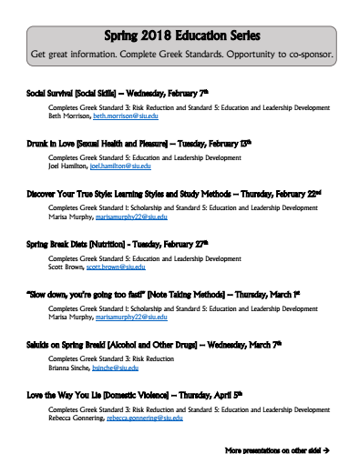
Continuing Education Series, cont.
Co-sponsorship
Bring 80% of chapter
Market the presentation to the Greek and SIU community
Arrive early to swipe IDs
B. Sinche 2018

Slide 18
THEMES – GREEK LEADER TRAINING
What is one thing you learned today that you think is important to educate/discuss with your members?
2016 - medical amnesty law
2017 - signs of alcohol poisoning
How will you change how you respond to difficult situations in the future?
2016 - know the signs of alcohol poisoning /be more proactive
2017 - actually calling 911 in times of emergency
What is one way you can lead by example?
2016 - being aware of my own drinking behaviors
2017 - practice what one preaches
B. Sinche 2018

Slide 19
Evaluation – NEW MEMBER EDUCATION
Overall
Workshop quality (3.56)
Workshop content (3.54)
Relevance to your personal/ professional development (3.29)
Workshop Outcomes
I gained new information about the topic. (3.30)
I learned useful strategies. (3.40)
Workshop Presenter(s)
Presenter(s) explained new ideas or strategies from this session well. (3.59)
Materials presented during the workshop were pertinent and useful. (3.57)
An appropriate balance between presentation and interaction was achieved. (3.58)
4 = Excellent or Strongly Agree
3 = Good or Agree
2 = Fair or Disagree
1 = Poor or Strongly Disagree
B. Sinche 2018

Slide 20
Evaluation – CONTINUING EDUCATION SERIES
Overall
Workshop quality (3.25)
Workshop content (3.28)
Relevance to your personal/ professional development (3.22)
Workshop Outcomes
I gained new information about the topic. (3.10)
I learned useful strategies. (3.12)
Workshop Presenter(s)
Presenter(s) explained new ideas or strategies from this session well. (3.25)
Materials presented during the workshop were pertinent and useful. (3.24)
An appropriate balance between presentation and interaction was achieved. (3.23)
4 = Excellent or Strongly Agree
3 = Good or Agree
2 = Fair or Disagree
1 = Poor or Strongly Disagree
632 participants Spring 2017 and Fall 2017 (Spring 2018 TBD)
B. Sinche 2018

Slide 21
NCHA Data EVALUATION (2015 -2017)
Last 30 day alcohol use
Statistically significant difference between FSL and non-members (p<.001)
No statistically significant difference between survey year
Number of drinks last time partied
Statistically significant difference between FSL and non-members (p<.001)
No statistically significant difference between survey year
Number of times drank 5 or more drinks in last two weeks
Statistically significant difference between FSL and non-members (p<.001)
Statistically significant difference between survey year (p<.001)
Two-way factorial ANOVA test – Factors included membership in a Fraternity or Sorority (Yes, No) and year of survey (2015, 2017)
B. Sinche 2018

Slide 22
FUTURE DIRECTIONS
Find new ways to:
present old information along with new
balancing engaging and entertaining
create interest in topics that are less popular, but important
engage more Multicultural and National Pan-Hellenic Council organizations
Consider incorporating:
sober monitor training
Integrate bystander training into this program
B. Sinche 2018

Slide 23
Questions?
Brianna Sinche, MPH Wellness and Health Promotion Services Student Health Services Southern Illinois University Carbondale bsinche@siu.edu 618-536-4441
shc.siu.edu/wellness-center/index.php
B. Sinche 2018

Slide 24
References
Barry, AE. (2007). Using theory-based constructs to explore the impact of Greek membership on alcohol-related beliefs and behaviors: A systematic literature review. Journal of American College Health, 56, 307– 315.
Borsari, B., Hustad, J. T. P., & Capone, C. (2009). Alcohol use in the Greek system, 1999–2009: A decade of progress. Current Drug Abuse Reviews, 2, 216–255.
Capone C, Wood MD, Borsari B, Laird RD. (2007). Fraternity and sorority involvement, social influences, and alcohol use among college students: A prospective examination. Psychology of Addictive Behaviors, 21(3):316–327.
Cashin JR, Presley CA, Meilman PW. (1998). Alcohol use in the Greek system: follow the leader? Journal of Studies on Alcohol, 59(1):63–70.
Chauvin, CD. (2012). Social norms and motivations associated with college binge drinking. Sociological Inquiry, 82, 257–281.
Cole, TB. (2006). Rape at US colleges often fueled by alcohol. Journal of the American Medical Association, 296, 504–505.
Harm Reduction International. (2018). What is harm reduction? Retrieved April 2, 2018: https://www.hri.global/what-is-harm-reduction
Knee CR, Neighbors C. (2002). Self-Determination, Perception of Peer Pressure, and Drinking Among College Students. Journal of Applied Social Psychology, 32(3):522–543.
Merriam Webster Dictionary. (2018). Definition of Intersectionality. Retrieved April 2, 2018: https://www.merriam-webster.com/dictionary/intersectionality
McCabe SE, Schulenberg JE, Johnston LD, O’Malley PM, Bachman JG, Kloska DD. (2005). Selection and socialization effects of fraternities and sororities on US college student substance use: A multicohort national longitudinal study. Addiction, 100(4):512–524.
McCauley, JL, Calhoun, KS, & Gidycz, CA. (2010). Binge drinking and rape: A prospective examination of college women with a history of previous sexual victimization. Journal of Interpersonal Violence, 25, 1655–1668.
LaBrie, JW, Kenney, SR, Mirza, T, & Lac, A. (2011). Identifying factors that increase the likelihood of driving after drinking among college students. Accident Analysis & Prevention, 43, 1371–1377.
Larimer ME, Anderson BK, Baer JS, Marlatt GA. (2000). An individual in context: Predictors of alcohol use and drinking problems among Greek and residence hall students. Journal of Substance Abuse, 11(1):53–68.
B. Sinche 2018

Slide 25
References
Lewis MA, Neighbors C. (2006). Social Norms Approaches Using Descriptive Drinking Norms Education: A Review of the Research on Personalized Normative Feedback. Journal of American College Health, 54(4):213–218.
National Institute on Alcohol Abuse and Alcoholism (2015). Planning Alcohol Interventions Using NIAAA’s College AIM. NIH Publication No. 15-AA-8017.
Nguyen, N, Walters, ST, Rinker, DV, Wyatt, TM, & DeJong, W. (2011). Fake ID ownership in a US sample of incoming first-year college students. Addictive Behaviors, 36, 759–761.
Page, RM, & O’Hegarty, M. (2006). Type of student residence as a factor in college students’ alcohol consumption and social normative perceptions regarding alcohol use. Journal of Child & Adolescent Substance Abuse, 15, 15–31.
Park A, Sher KJ, Krull JL.(2008). Risky drinking in college changes as fraternity/sorority affiliation changes: a person-environment perspective. Psychology of Addictive Behaviors, 22(2):219–229.
Perkins HW. (2002). Surveying the damage: a review of research on consequences of alcohol misuse in college populations. Journal of Studies on Alcohol, 14:91–100.
Ragsdale, K, Porter, JR, Mathews, R, White, A, Gore-Felton, C, & McGarvey, EL. (2012). ‘Liquor before beer, you’re in the clear’: Binge drinking and other risk behaviours among fraternity/sorority members and their non-Greek peers. Journal of Substance Use, 17, 323–339.
Scott-Sheldon, LA, Carey, KB, Kaiser, TS, Knight, JM, and Carey, MP. (2016). Alcohol Interventions for Greek Letter Organizations: A Systematic Review and Meta-Analysis, 1987 to 2014. Health Psychology, 35 (7): 670–684.
Sher KJ, Bartholow BD, Nanda S. (2001). Short- and long-term effects of fraternity and sorority membership on heavy drinking: a social norms perspective. Psychology of Addictive Behaviors, 15(1): 42–51.
Soule, EK, Barnett, TE., & Moorhouse, MD. (2015). Protective behavioral strategies and negative alcohol-related consequences among US college fraternity and sorority members. Journal of Substance Use, 20, 16–21.
Trockel M, Williams SS, Reis J. (2003). Considerations for more effective social norms based alcohol education on campus: An analysis of different theoretical conceptualizations in predicting drinking among fraternity men. Journal of Studies on Alcohol, 64(1):50–59.
B. Sinche 2018

Slide 26
References
Kilpatrick, Dean G., HeidiS. Resnick, Kennith J. Ruggiero, Lauren M. Conoscenti, and Jenna McCauley, (2007). Drug facilitated, Incapacitated and Forcible Rape: A National Study.
Reed, E., Amaro, H., Matsumoto, A., & Kaysen, D. (2009). The relation between interpersonal violence and substance use among a sample of university students: Examination of the role of victim and perpetrator substance use. Addictive Behaviors, 34, 316–318.
Krebs, CP, Lindquist, CH, Warner, TD, Fisher, B, and Martin, SL. (2009). College Women's Experiences with Physically Forced, Alcohol or Other Drug Enabled, and Drug Facilitated Sexual Assault Before and Since Entering College, Journal of American College Health, 57(6):639-64.
Mellins CA, Walsh K, Sarvet AL, Wall M,Gilbert L, Santelli JS, et al. (2017) Sexual assault incidents among college undergraduates: Prevalence and factors associated with risk. PLoSONE 12(11): e0186471.
B. Sinche 2018

