Slide 1
Characteristics and Components of Effective Prevention Programming
Presented By: Kasey Evans, M.S.
Assistant Director of the Illinois Higher Education Center
Eastern Illinois University

Slide 2
Why this workshop was created
Lack of utilization of evidence-based, evidence informed programs
Ongoing need to address topics which are void of evidence-based, evidence informed programs
Development of “home grown” programs
Pressure from administration to “do something,” particularly after crisis
Questions from others on how to choose “good programming”

Slide 3
How you may ultimately use this workshop
Educate other stakeholders regarding “better” prevention programs over “less desirable” programs
Advocacy for why certain programs/strategies are more desirable
Develop programs and interventions that are more likely to be effective and impacting
Use as a tool when deciding whether to adopt programs and interventions others have developed or are using.

Slide 4
Learning Outcomes
Participants will be able to:
Explain the differences in levels of prevention
Describe interventions that, alone, are unlikely to contribute to change in attitudes, beliefs, values, and behaviors
List characteristics and programmatic components of effective prevention programming
Better identify programs and interventions that will meet the characteristics and components of effective prevention programming.

Slide 5
When you think “prevention” program, what comes to mind?

Slide 6
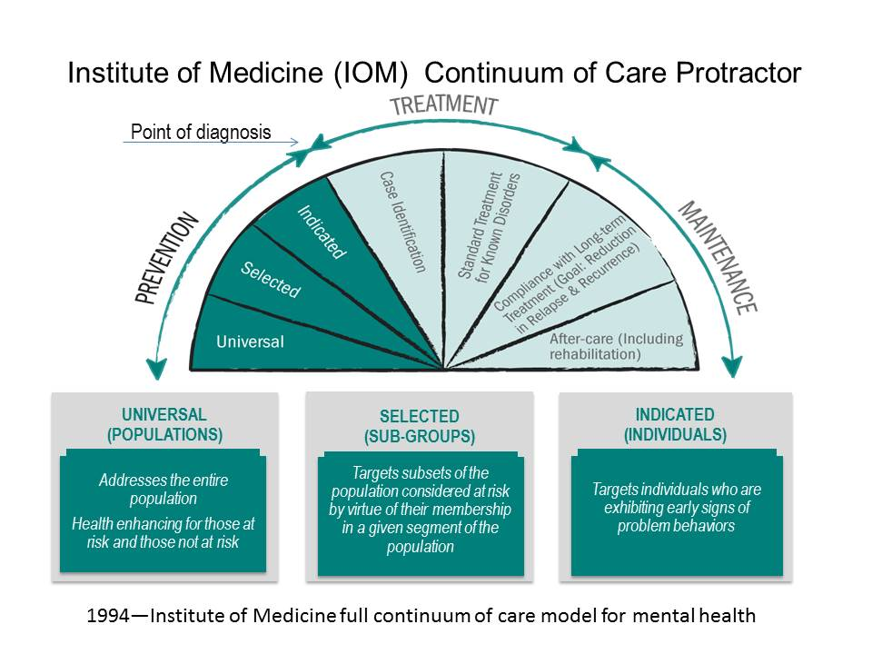
When you say “Prevention” do you really mean “Prevention”?

Slide 7
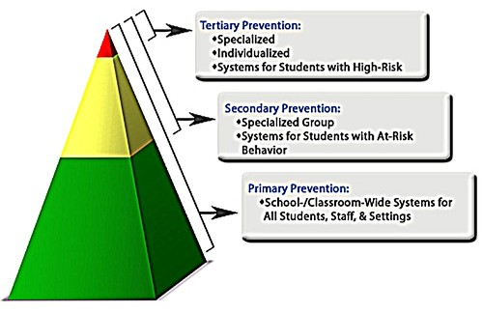
Prevention by Another Name

Slide 8
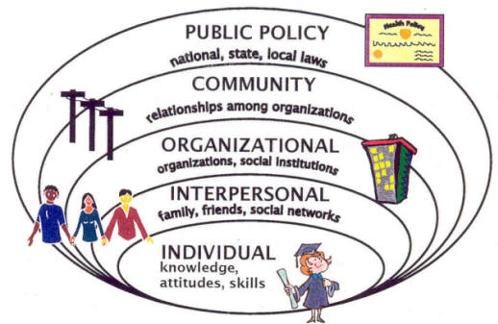
Is Your Institution Addressing Prevention Through a Socio-Ecological Model Approach?

Slide 9
Elements of Prevention Programs Using a Socio-Ecological Approach
Individual
Looking at individual knowledge, attitudes, beliefs, values
Addressing coping skills, particularly during transitions
Interpersonal
Bystander interventions
Conflict resolution/mediation
Partner communication
Organizational
Addressing social climate in school
Addressing perceived and actual social norms within the organization
Community
Improving relationships and communications between town and gown
Community mobilization/coalition strategies
Public Policy
Required training for those working with youth

Slide 10
Ten Primary Principles of Effective Prevention Interventions and Strategies “At a Glance”

Slide 11
 | Socio-Culturally Relevant | Well Trained Staff | Comprehensive | Varied Teaching Methods/Engaging | Sufficient Dosage | Theory Driven | Outcome Evaluation | Outcome Evaluation | Developmentally Appropriate | + Relationships | Appropriate Timing | Risk & Protective Factors | Evidence-Based | Defined Population
Berkowitz (2000) | X |  | X | X | X |  |  |  | X | X |  | X
Bond & Hauf (2004) | X | X | X |  | X | X | X | X | X |  | X
Borkowski, Akai & Smith (2007) | X | X | X | X | X | X | X | X |  | X | X
Borkowski, Smith, & Akai. (2006) | X | X | X | X | X | X | X | X
Bronte-Tinkew et al (2006) | X | X |  | X | X | X |  |  |  | X
Caspe & Lopez (2006) | X | X |  | X |  |  | X | X
CDC |  | X |  | X | X | X |  |  |  | X |  | X | X
Cuijpers (2002) |  |  | X | X |  | X |  |  |  |  |  |  | X
Durlak (2003) | X |  | X |  |  | X | X | X | X |  | X
Dusenbur, Falco,et al. (1997) | X | X | X | X |  |  |  |  | X |  | X
Dusenbury & Falco (1995) | X | X | X | X | X | X | X | X | X
Ennet et al. (2003) |  | X |  | X |  |  |  |  | X
Kumpfer & Alder (2003) | X |  | X |  | X |  |  |  | X | X
Kumpfer & Alvarado (2003) | X |  | X | X | X |  |  |  | X | X
Mazza (1997) |  |  |  |  |  | X | X | X |  |  |  | X
Nation et. al (2003) | X | X | X | X | X | X | X | X |  | X | X
National Office of Drug Control Policy (2014) | X | X |  |  |  |  |  |  |  |  | X | X | X | X
NIDA (2003) | X | X |  | X | X |  |  |  |  |  |  | X | X
Rotheram-Borus (2008) | X |  |  |  |  | X
Weissberg et. Al (2003) | X | X | X |  | X | X | X | X | X
 | 16 | 13 | 12 | 12 | 12 | 12 | 9 | 9 | 9 | 7 | 6 | 5 | 4 | 1

Slide 12
10 Primary Principles of Effective Prevention Interventions and Strategies “At a Glance”
Comprehensive Services
Varied Teaching Methods
Sufficient Dosage
Theory Driven
Positive Relationships
Appropriately Timed
Socio-Culturally Relevant
Outcome Evaluation
Well-Trained Staff
Developmentally Appropriate
Nation, M., Crusto, C., Wandersman, A., Kumpfer, K. L., Seybolt, D., Morrissey-Kane, E., & Davino, K. (2003). What works in prevention: Principles of Effective Prevention Programs. American Psychologist, 58, 449-456.

Slide 13
Comprehensive Services
Definition
Strategies should include multiple components and affect multiple settings to address a wide range of risk and protective factors of the target problem.
Important Points
Effective programs address multiple areas of a person’s life such as health, education, social connections, and social conditions by providing services in a variety of relevant settings.
Effective programs offer a wide variety of activities to address the target problem, which usually has multiple risk factors. These activities may include several components such as curriculum-based interventions, media campaigns, systems change, and environmental strategies that can affect economic-social conditions.

Slide 14
Varied Teaching Methods
Definition
Strategies should include multiple teaching methods, including some type of active, skills-based component.
Important Points
Methods should focus on the development of skills that enable the participants to avoid problem behaviors
Provide hands- on experiences for participants which allow skill practice

Slide 15
Sufficient Dosage
Definition
Participants need to be exposed to enough of the activity for it to have an effect.
Important Points
Can be measured by the number of contact hours.
Amount needed to produce outcomes is contingent on the participant’s level of risk and the amount deficits.
Provide some type of follow up or booster sessions.
One time presentations…rarely produce behavior change

Slide 16
Theory Driven
Definition
Prevention strategies should have a scientific justification or logical rationale.
Important Points
Describe a theory about how problem behaviors develop
Describe a theory of how or why the strategy is likely to change behavior
Use reverse engineering to prevent behavior problems and promote positive behaviors (logic modeling for program planning)

Slide 17
Positive Relationships
Definition
Programs should foster strong, stable, positive relationships between participants and others.
Important Points
Support the development of positive relationships
Provide an opportunity for participants to establish a strong relationship with at least one person
Mentoring
Careful not to depend too heavily on adult relationships focused on case management or therapy

Slide 18
Appropriately Timed
Definition
Program activities should happen at a time (developmentally) that can have maximal impact in a participant’s life
Important Points
Focus on the risk factors and/or risk behaviors before the develop
Tailored to the intellectual, cognitive, and social development level of participants

Slide 19
Socio-Culturally Relevant
Definition
Programs should be tailored to fit within cultural beliefs and practices of specific groups as well as local community norms
Important Points
Careful to tailor the content to make it culturally appropriate and relevant to its participants
Making a program socio-culturally relevant means…
Careful not to adopt a one-size-fits-all approach
Include participants in the program planning and implementation

Slide 20
Outcome Evaluation
Definition
A systematic outcome evaluation is necessary to determine whether a program or strategy worked
Important Points
Build an evaluation strategy into the implementation of the strategy (process evaluation)
Evaluation can be used to provide feedback at several stages
Should match the logic model of the program

Slide 21
Well-Trained Staff
Definition
Programs need to be implemented by staff members who are sensitive, competent, and have received sufficient training, support, and supervision. Follow up (booster) training and technical assistance to staff are critical
Important Points
Implemented by staff that receive formalized training
High rates of turnover, low morale, “buy in” issues

Slide 22
Developmentally Appropriate
Definition
Generally means to make decisions based on what the individual (s) need developmentally (generalized by age and stage)
Important Points
Student Develoment Theory Categories
Psychosocial. Focuses on long-term issues that tend to occur in sequence and are correlated with chronological age and 'life stages' by accomplishing certain deeds.
Cognitive-Structural. how students perceives and rationalize their experiences.
Person-Environment. interaction between conceptualizations of the college student and the college environment, looking at behavior as a social function of the person and the environment.
Humanistic Existential. concentrate on certain philosophical concepts about human nature: freedom, responsibility, self-actualization and that education and personal growth is encouraged byself-disclosure, self-acceptance and self-awareness. These theories are used extensively in counseling.
Student Development Process Models. Student development process models can be divided into abstract and practical.
Student Development Theory, University of Texas, Dallas

Slide 23
What Interventions Are We Employing that May Not Be Working?

Slide 24
What We Commonly See
Guest Speakers/Lectures/Assemblies (when alone)
Self Esteem Days (when alone)
Information Tables/Exhibits/Displays
Dead Days/Crashed Cars
Drunk Driving Simulators
Scare Tactics

Slide 25
Think About a Program You Are Currently Using

Slide 26
Comprehensive
Does the program include multiple components?
Does the program provide activities in more than one setting?
Do the activities happen in settings related to the risk and protective factors associated with the problem?

Slide 27
Varied Teaching Methods
Does the program include more than one teaching method?
Does the strategy include interactive instruction, such as role-play and other techniques for practicing new behaviors?
Does the strategy provide hands on learning experiences, rather than just presenting information or other forms of passive instruction?

Slide 28
Sufficient Dosage
Does the strategy provide more than one session?
Does the strategy provide sessions long enough to present the program content?
Does the intensity of the activity match the level of risk/deficits of the participants?
Does the strategy include a schedule for follow up or booster sessions?

Slide 29
Theory Driven
Does the program provide (or can you identify) a theory of how the problem behaviors develop?
Does the program articulate a theory of how and why the intervention is likely to produce change?
Bring your model of the problem and model of the solution together to develop a logic model.
Based on the model of the problem and the model of the solution, do you believe that the program is likely that the program will produce change?

Slide 30
Appropriate Timing
Does the strategy happen before participants develop the problem behavior?
Is the strategy timed strategically to have an impact during important developmental milestones related to the problem behavior?
Does the activity content seem developmentally (intellectually, cognitively) appropriate for the target population?

Slide 31
Socially/Culturally Relevant
Does the strategy appear to be sensitive to the social and cultural realities of the participants?
If not, are you capable of making the changes that are needed to make it more appropriate?
Is the strategy flexible to deal with special circumstances or individual needs of potential participants?
Is it possible to consult some potential participants to help you evaluate and/or modify the strategy?

Slide 32
Outcome Evaluation
Is there a plan for evaluating the program?
Does the evaluation plan provide feedback prior to the end of the program?
Is there a plan for receiving feedback throughout the program development and implementation?

Slide 33
Well-Trained Staff
Is there sufficient staff to implement the program?
If so, has the staff received sufficient training and supervision and support to implement the program properly?
Will efforts be made to encourage stability and high morale in the staff members who will provide the program?

Slide 34
Developmentally Appropriate
Does program methods and content align with participant physical abilities?
Does program methods and content align with participant cognitive abilities?
Does program align with where students are morally? Where they are in transition

Slide 35
Questions?

Slide 36
Contact Information
Kasey Evans, M.S.
kgevans@eiu.edu

Slide 37
References and Sources
Berkowitz, A. D. (2000). Critical Elements of sexual assault prevention and risk reduction programs for men and women. Sexual assault in context: teaching men and women about gender.
Cooper, W. O., Lutenbacher, M., Fuccia, K. (2000). Components of effective youth violence prevention programs for 7 to 14 year-olds. Archive of Pediatric and Adolescent Medicine, 154, 1134-1139.
Cuijpers, P. (2002). Effective ingredients of school-based drug prevention programs, a systematic review. Addictive Behaviors, (27), 1009-1023.
Durlak, J. A., Weissberg, R. P., Pachan, M. (2010). A meta-analysis of after-school programs that seek to promote personal and social skills in children and adolescents. American Journal of Community Psychology.
Dusenbury, L., Falco, M. (1997). Characteristics of effective substance abuse prevention programs. ResearchBrief, 1(26).
Dusenbury, L., Falco, M., Lake, A., Brannigan, R., Bosworth, K. (1997). Nine critical elements of promising violence prevention programs. Journal of School Health, 67(10), 409-414.
Dusenbury, L., Falco, M. (1995). Designing Effective Prevention Programs, How good Science Makes Good Art. Journal of School Health, 65(100), 420-441.
Ennett, S. T., Ringwalt, C. L., Thorne, J., Rohrbach, L. A., Vincus, A., Simons-Rudolph, A., Jones, S. (2003). A comparison of current practice in school-based substance useprevention programs with menta-analysis findings. Prevention Science, 4(1), 1-14.

Slide 38
References and Sources
Gottfredson, D. C., Wilson, D. B. (2003). Characteristics of effective school-based substance abuse prevention. Prevention Science, 4(1), 27-38.
Knox, L. M., Spivak, H. (2005). What health professionals should know: Core competencies for effective practice in youth violence prevention. American Journal of Preventative Medicine, 191-199.
Mazza, J. J. (1997). School-based suicide prevention programs: Are they effective? School Psychology Review, 26(3), 382-396.
Merell, K. W., Isava, D. M. (2008). How effective Are school bullying intervention programs? School Psychology Quarterly, 23(1), 26-42.
Nation, M., Crusto, C., Wandersman, A., Kumpfer, K., Seybolt, D., Davino, E. M., Davono, K. (2003). What works in prevention. American Psychologist, 58(6/7), 449-456.
Unknown. (2007). Identifying and selecting evidence-based interventions. Department of Health and Human Services. 1-25.
Rotheram-Borus, M. (2008). Common Factors in Effective HIV Prevention Programs. Aids and behavior.
Small, S. A., Cooney, S. M., O’Connor, C. (2009). Evidence-Enforced Program Improvement: Using principles of effectiveness to enhance the quality and impact of family-based prevention programs. Family Relations, 58, 1-13.
Springer, F., Sale, E., Hermann, J., Sambrano, S., Kasim, R., Nistler, M. (2004). Characteristics of effective substance abuse prevention programs for high-risk youth. The Journal of Primary Prevention, 25(2), 171-194.
Wandersman, A., Morrisey, E., Davino, K., Seybolt, D., Crusto, C., Nation, M., Goodman, R., Imm, P. (1998). Comprehensive quality programming and accountability: eight essential strategies for implementing successful prevention programs. The Journal of Primary Prevention, 19(1), 3-29.
Wilson, D. B., Gottfredson, D. C., Najaka, S. S. (2001). School-based prevention of problem behaviors: a meta-analysis. Journal of Quantitative Ciminology, 17(3), 247-271.

