Slide 1
Motivation and Goal Setting
Procrastination
Study/Test-Taking Skills
Brian Gorman
Assistant Director, SSC
Eastern Illinois University

Slide 2
Ask yourself these questions:
Why am I here (in college)?
What do I want to get out of this experience?
Where do I see myself at the end of the semester, the year?
Where do I see myself in 4 years, 10 years?

Slide 3
Which do you have the most value in?
Motivation = Value X Expectation
Whatever tasks/goals you have the most value in, those are the tasks/goals you are likely to achieve.
However, you must also have a high expectation for yourself
https://www.youtube.com/watch?v=Kave0ZOC47U&list=UUqA0jUAH_7QkB2o2typ3FpQ

Slide 4
Intrinsic vs. Extrinsic Motivation
Intrinsic – motivation from within
  Personal desire, curiosity, high value, achievement
Extrinsic – motivation from outside influences
  Grades, GPA, prestige, rewards
Students with Intrinsic motivation are much more likely to succeed in the classroom

Slide 5
Extrinsic Motivation
According to the US Census Bureau:
  College graduates earn an average of $1 million more than HS grads in a lifetime
  6/10 jobs require higher education
  # of jobs requiring advanced skills grow twice the rate of basic skills jobs
College graduates enjoy
  Higher savings levels
  Improved working conditions
  Increased personal and professional mobility
  Improved health and life expectancy
  Better lives for offspring
  Better consumer decisions
  Increased status
  More hobbies and leisure activities
  * Institute for Higher Education and the Carnegie Foundation

Slide 6
What other Extrinsic Motivators are there?
Ability to not only graduate but get the job you want?
Ability to live where you want?
Provide a great life for your family?
Big house, 5 cars, your own private island?

Slide 7
Intrinsic Motivation
If you don’t have it, How do you get it?

Slide 8
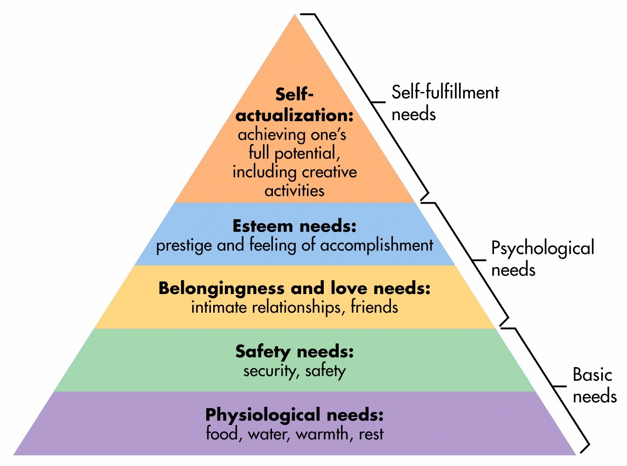
Abraham Maslow’s Hierarchy of Needs
Intrinsic Motivation – If we satisfy our deficiency needs (bottom four), we have a much higher likelihood of developing an inner motivation

Slide 9
SMART Goals
Specific (and Strategic) – more specific, easier to identify and reach
  WHO, WHAT?
Measurable – can you measure it?
  HOW?
Attainable – are they reasonable, realistic?
Relevant – your life role, focus on a single defined area
  EXPECTED RESULT?
Time/Tangible– clearly define a deadline/is it doable?
  WHEN?

Slide 10
Create your own SMART GOALS
Life Role: student
Create a SMART goal
Create a list of things you can do to achieve the goal by your deadline – BE DELIBERATE!!
Short term ( 1-2 weeks)
Middle (this semester, one year)
Long term (graduation and beyond)

Slide 11
Create a Life Plan
Complete a life plan for your role as a student
My Dream: Do you have a dream? If not, “I’m searching”
My Role: Student
My Long-Term Goals
My Short-Term Goals

Slide 12
Procrastination
We all procrastinate, you’re not special
Why do we procrastinate?
  Little value
  Temporal Discounting
  Dopamine (pleasure chemical) that other alternatives provide
  Lazy
  Fear of failure/unknown
  Poor self-esteem
  Poor time management/prioritization skills
https://www.youtube.com/watch?v=1nBwfZZvjKo

Slide 13
So what can we do?
“Procrastination is a symptom, not a cause.”
  Properly motivate
Reward yourself for completing tasks early
Pomodoro Technique – 25 mins of work, reward yourself
Positive Thinking – enjoy the achievement
  Don’t think: “ugh, I have to study”
  Do think: “When I’m finished here I will be prepared and enjoy myself later”
Create self imposed deadlines – internal and external
Create a list reminding yourself why you should finish early

Slide 14
Best Practices - Studying

Slide 15
Effective Test Taking
Based on your Test-Taking Inventory, what changes can you make?
Before, During, and after a Test
Multiple Choice
True-False
Fill in the Blank
Short Answer
Matching

Slide 16
The Power of Choice
Your quality of life is determined by the choices YOU make every day
What would you like your quality of life to be?
What is most important?
What are you going to do about it?

