Slide 1

Recipes for Families

Slide 2
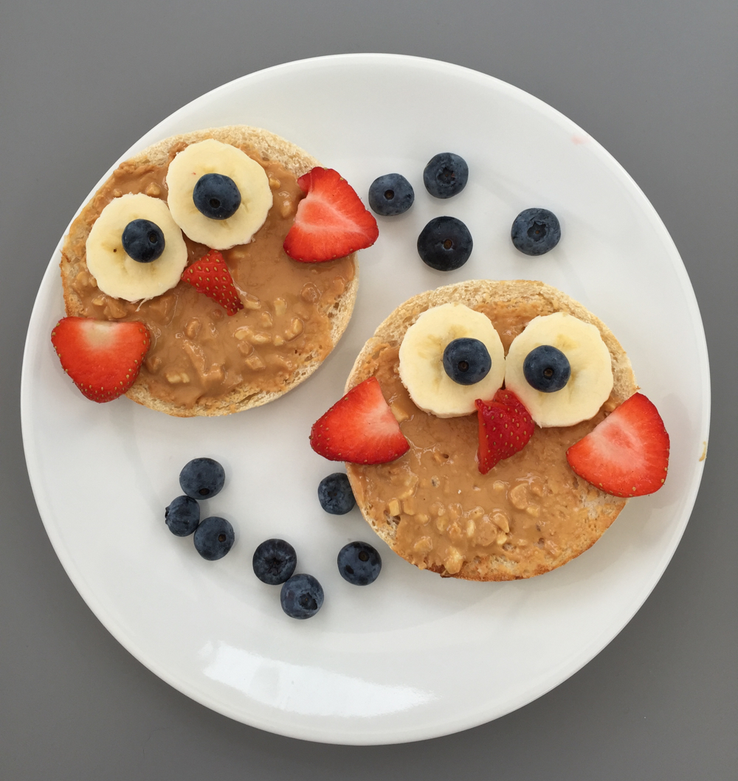
Wise Owl Fruity Toast for Breakfast
Ingredients
1 English Muffin-sliced open
2 tablespoons Peanut Butter
1 banana- sliced
2 strawberries- sliced
4 blueberries

Slide 3
How to Make Wise Owl Fruity Toast
Instructions
Slice the English muffin in half
Toast the English muffin until just lightly browning
Spread smooth peanut butter onto the toasted muffin halves
Choose two big juicy strawberries and slice them- this will make the owl wings
Cut two smaller triangles of strawberry –these will make the little owl beaks
Choose some juicy blueberries to be owl eye balls
Peel and slice the banana- these will make the owl eyes
Put the banana slices onto the peanut butter spread muffins as eyes
Put the blueberries on top of the banana slices to complete the owl eyes
Add the strawberry slices as wings and the little strawberry triangles as the owl beaks
Enjoy!

Slide 4
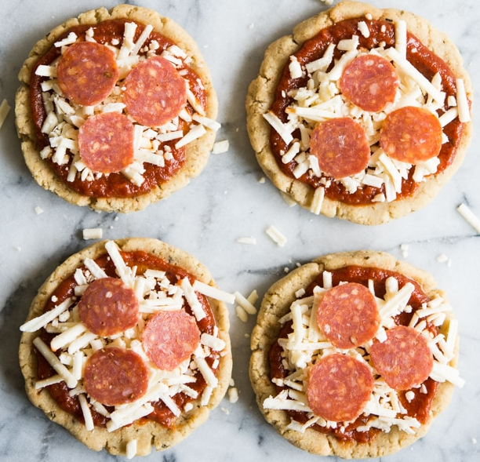
Kid Friendly Mini Lunchable Pizzas
Prep Time: 10 minutes Servings: 6
Cook Time: 10 minutes
Ingredients
1 Box of Simple Mills Pizza Crust Mix
2 tablespoons apple cider vinegar
2 tablespoons extra virgin olive oil
6 tablespoons water
2 ounces mini pepperoni
4-6 ounces shredded mozzarella cheese
1 small jar of pizza sauce

Slide 5
How to Make Mini Lunchable Pizzas
Instructions
Preheat oven to 350 degrees
Mix dough according to the direction on the box
Make your dough into 6-7 balls, and then press each ball into a small circular crust
Place each crust on a lightly greased baking sheet, and bake for 10 minutes
Remove from oven and let cool completely if packing for lunch, or assemble toppings and consume when cooled right away
When ready to eat, layer tomato sauce on first, then top with shredded cheese and pepperonis
Enjoy!

Slide 6
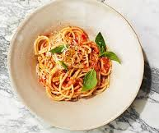
Spaghetti with Fresh Tomato-Basil Sauce
Prep Time: 25 minutes Servings: 4 to 6
Total Time: 30 minutes
Ingredients
Kosher salt and freshly ground pepper
12 ounces long pasta, such as spaghetti or linguine
¼ cup extra-virgin olive oil, plus more for serving
4 cloves garlic, minced (2 tablespoons)
2 pounds beefsteak tomatoes (3 cups)
2 basil sprigs
1 ounce Parmigiano-Reggiano grated cheese (1/2 cup packed), plus more for serving

Slide 7
How to Make Spaghetti
Instructions
Bring a large pot of salted water to a boil. Add pasta and cook until slightly less than al dente, about 2 minutes less than package directions. Reserve 1 cup pasta water, then drain
Meanwhile, heat oil and garlic in a large straight-sided skillet over medium-high until just sizzling, about 30 seconds. Add tomatoes and basil sprigs; season with salt and pepper. Bring to a boil, then reduce heat to medium and simmer until reduced to about 2 cups, 8 to 10 minutes. Discard basil
Add pasta and ¼ cup pasta water; cook, stirring, until pasta is cooked through, 1 to 2 minutes. Remove from heat. Add cheese and continue stirring and shaking pan, adding more pasta water as needed to create a creamy sauce. Serve, sprinkled with more cheese, basil leaves, and pepper, and drizzled with oil
Enjoy!

Slide 8
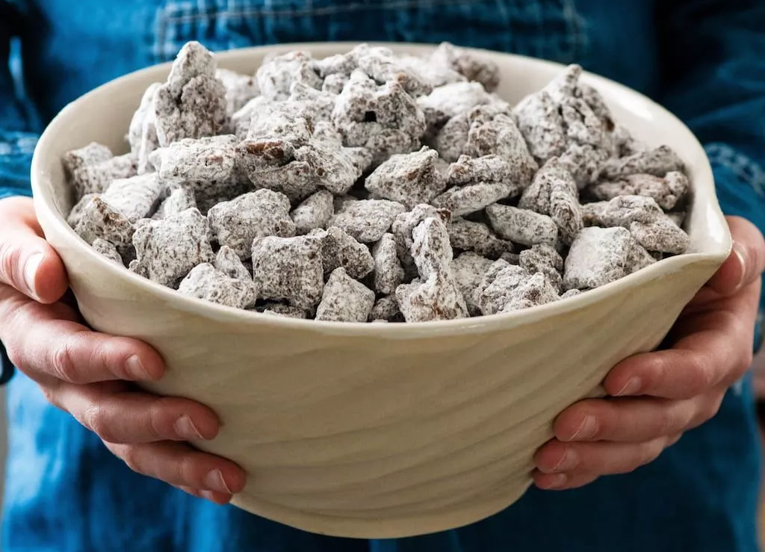
Puppy Chow (Muddy Buddies) Dessert
Prep Time: 10 minutes Chilling Time: 20 minutes
Total Time: 30 minutes Servings: 15 servings
Ingredients
1 cup semisweet or dark chocolate chips
1 cup creamy peanut butter
6-7 cups Rice Chex Cereal
1-2 cups powdered sugar

Slide 9
How to Make Puppy Chow
Instructions
Melt peanut butter and chocolate together, either on the stovetop or in the microwave
Next, add 3 cups of cereal to a large bowl. Pour 1 cup of your chocolate/peanut butter mixture over the cereal
Add 3 more cups of cereal to the bowl and then pour the rest of the chocolate/peanut butter mixture on top
Stir until the cereal is evenly coated. If there are pools of chocolate/peanut butter at the bottom of your bowl, add more cereal ¼ cup at a time until all that deliciousness is coating your cereal. Remember we WANT clumps, so do NOT add too much cereal!
Let the mixture cool slightly. You do not want it to harden!
Once your mixture is at or below room temperature, add 1 cup of powdered sugar. Mix until combined
Let cool for about 15 minutes
Add more powdered sugar ¼ cup at a time until your cereal is coated to your satisfaction
Store in an airtight container at room temperature
Enjoy!

Slide 10
Enjoy!

